Slide 1

GraphQL Meetup Hamburg | June 2018 | @nilshartmann
NILS HARTMANN
Schema
Stitching
with Apollo GraphQL
Slides: https://bit.ly/meetup-schema-stitching

Slide 2
@nilshartmann
NILS HARTMANN
Software Developer from Hamburg
JavaScript, TypeScript, React
Java
Trainings, Workshops
nils@nilshartmann.net

Slide 3
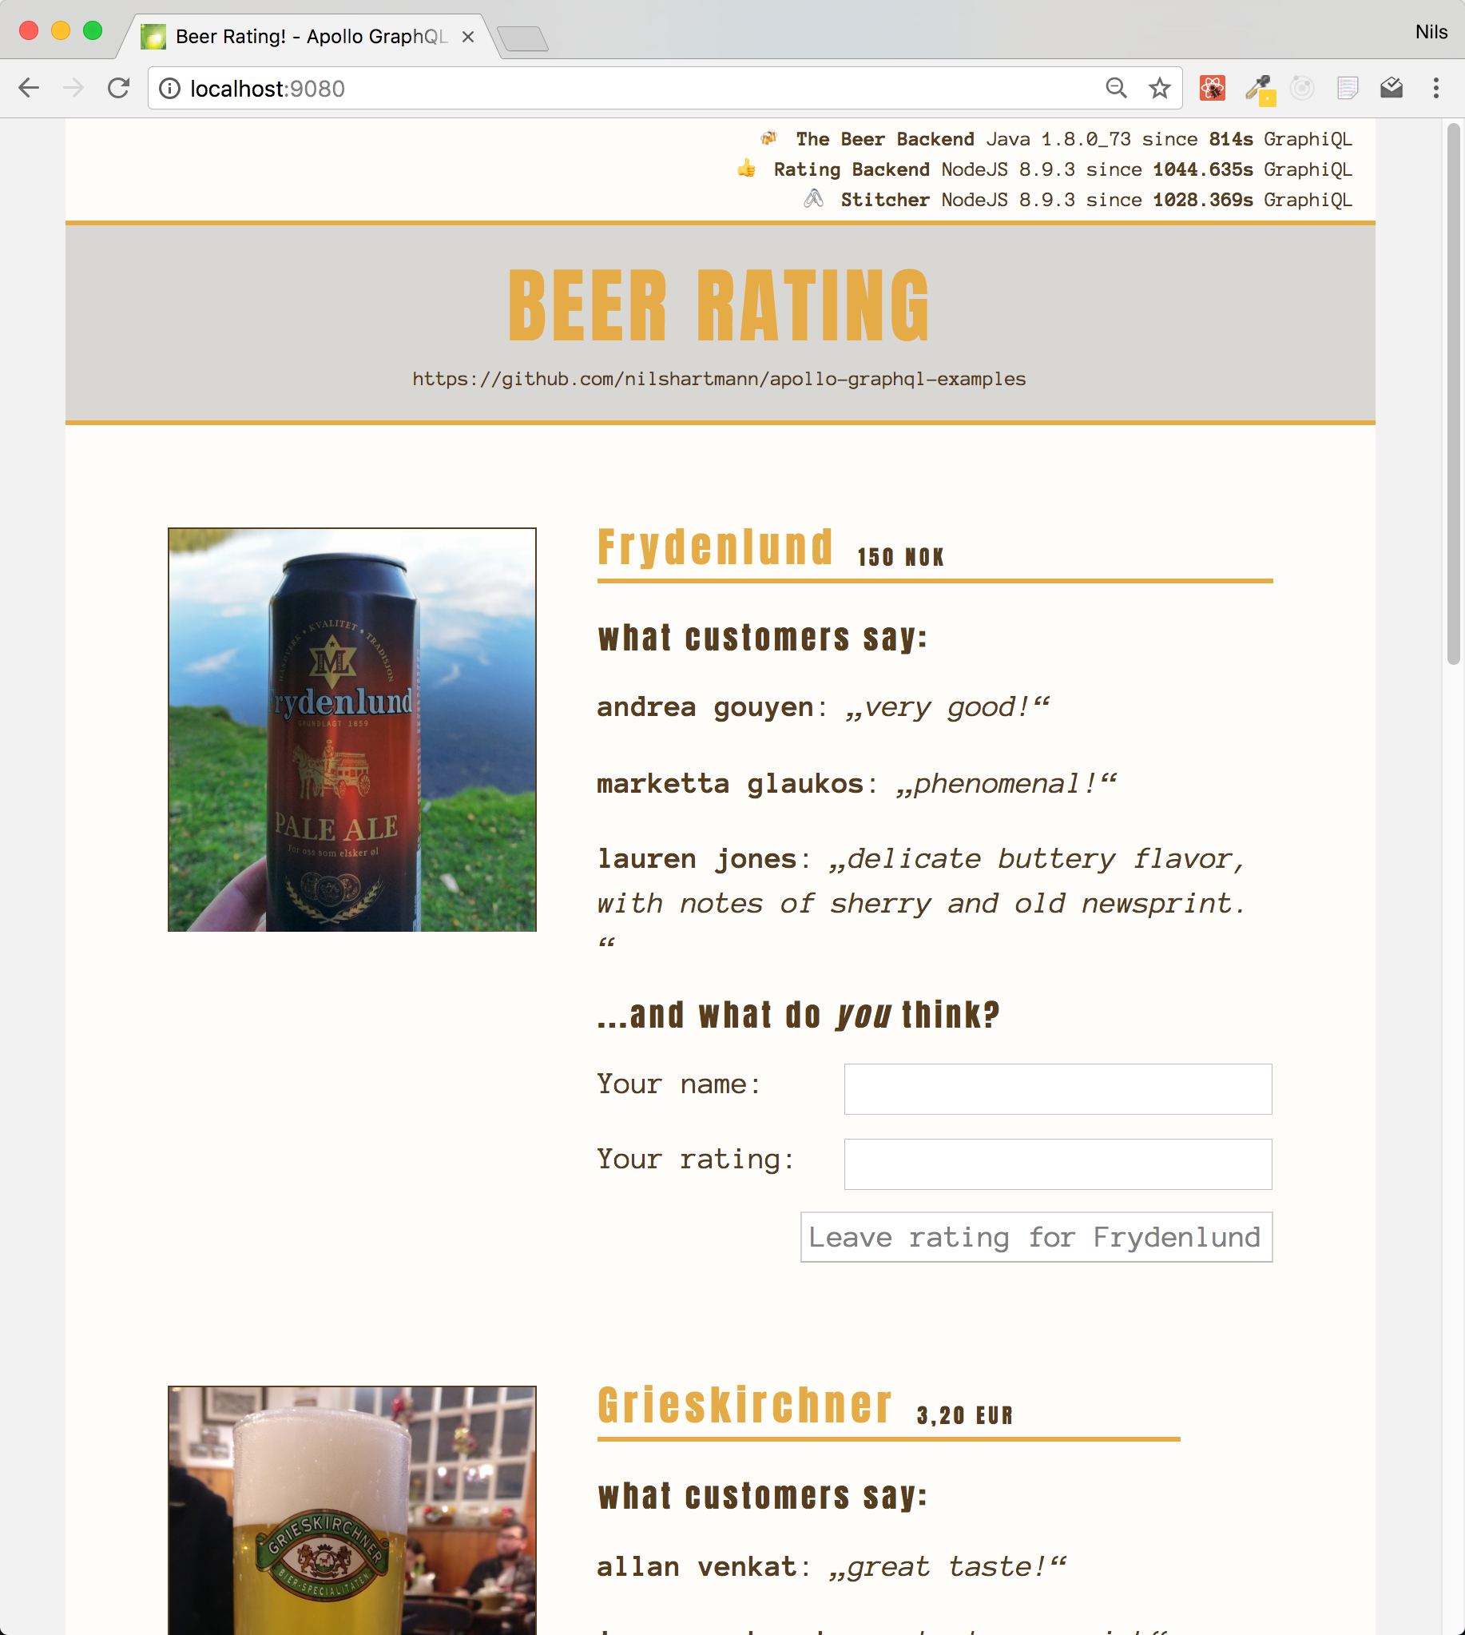
Source Code: https://bit.ly/graphql-stitching-example
Example

Slide 4
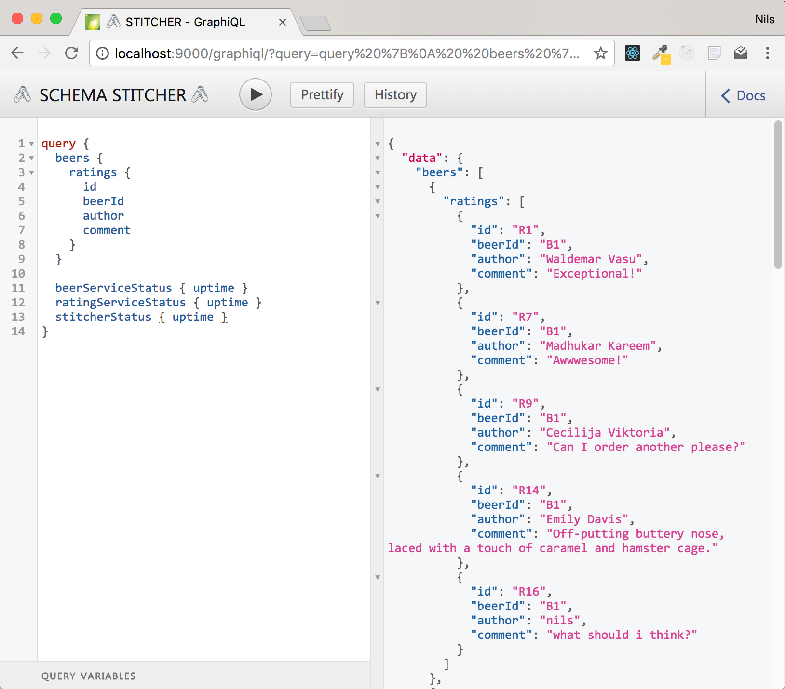
http://localhost:9000
Demo: GraphiQL

Slide 5
Architecture

Slide 6
Align Multiple APIs
Rename ambigous
types and fields

Slide 7
Align Multiple APIs
Add fields to
existing types by
linking to
schemas

Slide 8
Apollo GraphQL
Apollo Server: https://www.apollographql.com/docs/apollo-server/
Open-Source-Framework for building GraphQL Server (JavaScript)
Exposes Types and Resolver (Schema) via HTTP endpoint

Slide 9
Tasks
Implementing a Schema Stitcher using Apollo Server...
Create a "Remote Schema" for each endpoint
Rename the ProcessInfo type from each schema
Create the "link" between the two schemas
Add ratings field to Beer type
Merge schemas into one new Schema
Expose merged Schema via HTTP Endpoint

Slide 10
Create Remote Schemas
1. Configure Network Connection
import { HttpLink } from "apollo-link-http";
import fetch from "node-fetch";
import { introspectSchema, makeRemoteExecutableSchema } from "graphql-tools";
async function createRemoteSchema(uri) {
const link = new HttpLink({ uri, fetch });
const schema = await introspectSchema(link);
return makeRemoteExecutableSchema({
schema,
link
});
}
const beerSchema = await createRemoteSchema("localhost:9010/graphql");
const ratingSchema = await createRemoteSchema("localhost:9020/graphql");

Slide 11
Create Remote Schemas
2. Run GraphQL introspection query
Standard query for retrieving a schema
import { HttpLink } from "apollo-link-http";
import fetch from "node-fetch";
import { introspectSchema, makeRemoteExecutableSchema } from "graphql-tools";
async function createRemoteSchema(uri) {
const link = new HttpLink({ uri, fetch });
const schema = await introspectSchema(link);
return makeRemoteExecutableSchema({
schema,
link
});
}
const beerSchema = await createRemoteSchema("localhost:9010/graphql");
const ratingSchema = await createRemoteSchema("localhost:9020/graphql");

Slide 12
Create Remote Schemas
3. Create an executable schema
Executable Schema is Apollo's schema abstraction
import { HttpLink } from "apollo-link-http";
import fetch from "node-fetch";
import { introspectSchema, makeRemoteExecutableSchema } from "graphql-tools";
async function createRemoteSchema(uri) {
const link = new HttpLink({ uri, fetch });
const schema = await introspectSchema(link);
return makeRemoteExecutableSchema({
schema,
link
});
}
const beerSchema = await createRemoteSchema("localhost:9010/graphql");
const ratingSchema = await createRemoteSchema("localhost:9020/graphql");

Slide 13
Create Remote Schemas
4. Create the remote schemas
Need to do this for each remote endpoint
import { HttpLink } from "apollo-link-http";
import fetch from "node-fetch";
import { introspectSchema, makeRemoteExecutableSchema } from "graphql-tools";
async function createRemoteSchema(uri) {
const link = new HttpLink({ uri, fetch });
const schema = await introspectSchema(link);
return makeRemoteExecutableSchema({
schema,
link
});
}
const beerSchema = await createRemoteSchema("localhost:9010/graphql");
const ratingSchema = await createRemoteSchema("localhost:9020/graphql");

Slide 14
Tasks
Implementing a Schema Stitcher...
Create a "Remote Schema" for each endpoint
Rename the ProcessInfo type from each schema
Create the "link" between the two schemas
Add ratings field to Beer type
Merge schemas into one new Schema
Expose merged Schema via HTTP Endpoint

Slide 15
Transforming Schemas
Rename Types and Root-Fields for our overall Schema
Type ProcessInfo to {System}Status

Slide 16
Transforming Schemas
Step 2: Rename Types and Root-Fields
Type ProcessInfo to {System}Status
Root-Field ping to {system}Status

Slide 17
Transforming Schemas
1. transformSchema runs a list of Transform operations
Returns new Apollo Schema instance
import { transformSchema } from "graphql-tools";
function renameInSchema(schema) {
return transformSchema(schema, [
]);
}

Slide 18
Transforming Schemas
2. Rename Type ProcessInfo to {System}Status
import { transformSchema, RenameTypes, RenameRootFields } from "graphql-tools";
function renameInSchema(schema, systemName) {
return transformSchema(schema, [
new RenameTypes(
name => (name === "ProcessInfo" ? `${systemName}Status` : name
),
new RenameRootFields(
(op, name) => name === "ping" ? : `${systemName}Status` : name
)
]);
}

Slide 19
Transforming Schemas
3. Rename Root-Field ping to {system}Status
import { transformSchema, RenameTypes, RenameRootFields } from "graphql-tools";
function renameInSchema(schema, systemName) {
return transformSchema(schema, [
new RenameTypes(
name => (name === "ProcessInfo" ? `${systemName}Status` : name
),
new RenameRootFields(
(op, name) => name === "ping" ? : `${systemName}Status` : name
)
]);
}

Slide 20
Transforming Schemas
4. Run the transformation in both Schemas
import { transformSchema, RenameTypes, RenameRootFields } from "graphql-tools";
function renameInSchema(schema, systemName) {
return transformSchema(schema, [
new RenameTypes(
name => (name === "ProcessInfo" ? `${systemName}Status` : name
),
new RenameRootFields(
(op, name) => name === "ping" ? : `${systemName}Status` : name
)
]);
}
const renamedBeerSchema = renameInSchema(beerSchema, "Beer");
const renamedRatingSchema = renameInSchema(ratingSchema, "Rating");

Slide 21
Tasks
Implementing a Schema Stitcher...
Create a "Remote Schema" for each endpoint
Rename the ProcessInfo type from each schema
Create the "link" between the two schemas
Add ratings field to Beer type
Merge schemas into one new Schema
Expose merged Schema via HTTP Endpoint

Slide 22
Link Schemas
Enhance existing schema
Add ratings to Beer Schema

Slide 23
Link Schemas
Enhance existing schema
Add ratings to Beer Schema
Implementation: Delegate ratings to Rating API

Slide 24
Link Schemas
1. Extend existing Type
Add ratings field to Beer Schema
function createLinkedSchema() {
return {
linkedTypeDefs: `
extend type Beer {
ratings: [Rating!]!
}
`
}
}

Slide 25
Link Schemas
2. Add Resolver function
Naming convention as in "regular" Apollo Resolvers
function createLinkedSchema(ratingSchema) {
return {
linkedTypeDefs: `extend type Beer {ratings: [Rating!]! }`,
linkedResolvers: {
Beer: {
ratings: {
fragment: `fragment BeerFragment on Beer { id }`,
resolve: (parent, args, context, info) =>
info.mergeInfo.delegateToSchema({
schema: ratingSchema,
operation: "query",
fieldName: "ratingsForBeer",
args: { beerId: parent.id },
context, info
});
}
}
}
}
}

Slide 26
Link Schemas
3. Use Fragment to add fields needed for resolver
Ensures that all required fields are queried, even if not specified in user's query
function createLinkedSchema(ratingSchema) {
return {
linkedTypeDefs: `extend type Beer {ratings: [Rating!]! }`,
linkedResolvers: {
Beer: {
ratings: {
fragment: `fragment BeerFragment on Beer { id }`,
resolve: (parent, args, context, info) =>
info.mergeInfo.delegateToSchema({
schema: ratingSchema,
operation: "query",
fieldName: "ratingsForBeer",
args: { beerId: parent.id },
context, info
});
}
}
}
}
}

Slide 27
Link Schemas
4. Delegate execution to other schema ("Rating" in our example)
function createLinkedSchema(ratingSchema) {
return {
linkedTypeDefs: `extend type Beer {ratings: [Rating!]! }`,
linkedResolvers: {
Beer: {
ratings: {
fragment: `fragment BeerFragment on Beer { id }`,
resolve: (parent, args, context, info) =>
info.mergeInfo.delegateToSchema({
schema: ratingSchema,
operation: "query",
fieldName: "ratingsForBeer",
args: { beerId: parent.id },
context, info
});
}
}
}
}
}

Slide 28
Link Schemas
4. Delegate execution to other schema ("Rating" in our example)
function createLinkedSchema(ratingSchema) {
return {
linkedTypeDefs: `extend type Beer {ratings: [Rating!]! }`,
linkedResolvers: {
Beer: {
ratings: {
fragment: `fragment BeerFragment on Beer { id }`,
resolve: (parent, args, context, info) =>
info.mergeInfo.delegateToSchema({
schema: ratingSchema,
operation: "query",
fieldName: "ratingsForBeer",
args: { beerId: parent.id },
context, info
});
}
}
}
}
}
Runs on Rating Schema:
query {
ratingsForBeer(beerId: ...) {
...
}
}

Slide 29
Tasks
Implementing a Schema Stitcher...
Create a "Remote Schema" for each endpoint
Rename the ProcessInfo type from each schema
Create the "link" between the two schemas
Add ratings field to Beer type
Merge schemas into one new Schema
Expose merged Schema via HTTP Endpoint

Slide 30
Merge Schemas
Recap: Create, Transform and Link Schemas
import { mergeSchemas } from "graphql-tools";
const beerSchema = await createRemoteSchema("localhost:9010/graphql");
const ratingSchema = await createRemoteSchema("localhost:9020/graphql");
const renamedBeerSchema = renameInSchema(beerSchema, "Beer");
const renamedRatingSchema = renameInSchema(ratingSchema, "Rating");
const { linkedTypeDefs, linkedResolvers } = createLinkedSchema(renamedRatingSchema);
const mergedSchema = mergeSchemas({
schemas: [
renamedBeerSchema,
renamedRatingSchema,
linkedTypeDefs
],
resolvers: linkedResolvers
});

Slide 31
Merge Schemas
1. Merge Schemas together
import { mergeSchemas } from "graphql-tools";
const beerSchema = await createRemoteSchema("localhost:9010/graphql");
const ratingSchema = await createRemoteSchema("localhost:9020/graphql");
const renamedBeerSchema = renameInSchema(beerSchema, "Beer");
const renamedRatingSchema = renameInSchema(ratingSchema, "Rating");
const { linkedTypeDefs, linkedResolvers } = createLinkedSchema(renamedRatingSchema);
const mergedSchema = mergeSchemas({
schemas: [
renamedBeerSchema,
renamedRatingSchema,
linkedTypeDefs
],
resolvers: linkedResolvers
});

Slide 32
Publish merged Schema
Publish Schema
Example: Using HTTP Endpoint with Express
import { graphqlExpress } from "apollo-server-express";
import express from "express";
import bodyParser from "body-parser";
const mergedSchema = mergeSchemas(. . .);
const app = express();
app.use("/graphql",
bodyParser.json(),
graphqlExpress({ schema: mergedSchema })
);
app.listen(PORT);

Slide 33
@nilshartmann
🍻
Thank you!
Slides: https://bit.ly/meetup-schema-stitching
Sample-Code: https://bit.ly/graphql-stitching-example

